Slide 1



Preparing for AI as a Salesforce Professional
Stella Durante

Slide 2
Scenario: Arizona State University (ASU)
Arizona State University (ASU) is a public research institute consistently recognized as the most innovative school in the United States.
Up until this point, ASU used Forms and Google Sheets to manage course enrollment.
They recently hired our team to adjust their system to begin using Salesforce to manage course enrollment, as there has been an increase in demand for expanded course offerings.

Slide 3
Project Objectives
Salesforce adoption aims to:
Automate enrollment processes and data management, aiming to support 100 courses efficiently with existing staff.
Enhanced reporting capabilities for real-time insights on course status, enrollments, and waitlist management to inform marketing and strategic decisions.
Reduce manual workload for staff, allowing them to focus on value-added activities and improve the student enrollment experience through a single interface.

Slide 4
Project Overview
Interview stakeholder
GPT Assisted Insights Extracts
Create BPM Using UPN
GPT Assisted User Stories
Org Setup and Data Load
MVP

Slide 5
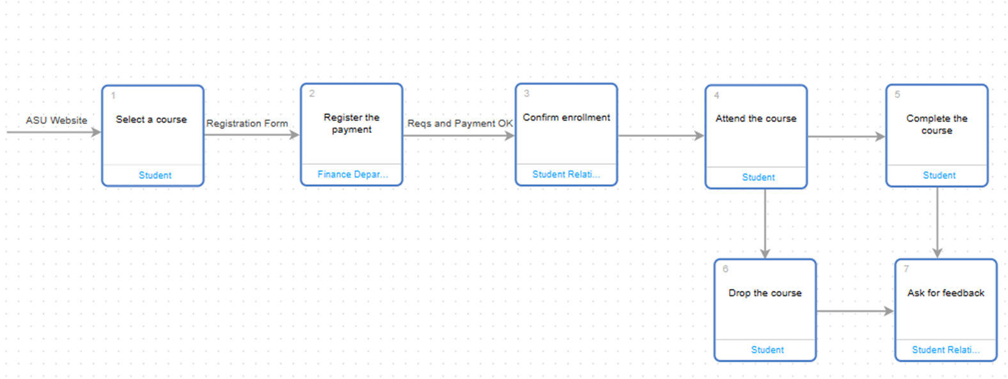
"Course Enrollment Workflow"

Slide 6
User Story 1
Registration Form:
As a student,
I want to fill out a registration form with my personal details and contact information, ensuring all required information is captured accurately,
So that to complete the enrollment process successfully.
Given I am a student,
when I present a registration form that collects necessary personal details, including full name, contact information, and any additional required information,
then the enrollment process complete successfully.

Slide 7
User Story 2
Payment Process:
As a student,
I want a smooth payment processing experience, with a secure payment gateway,
So that to easily complete the course fee payment and confirm my enrollment.
Given I am a student,
When I make the payment,
Then I receive a confirmation of payment and enrollment.

Slide 8
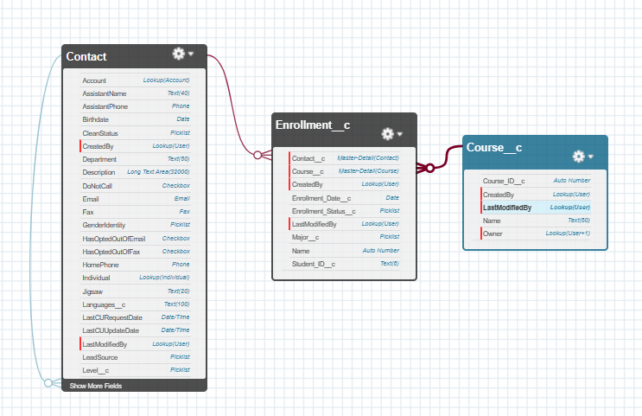
Org
Setup

Slide 9
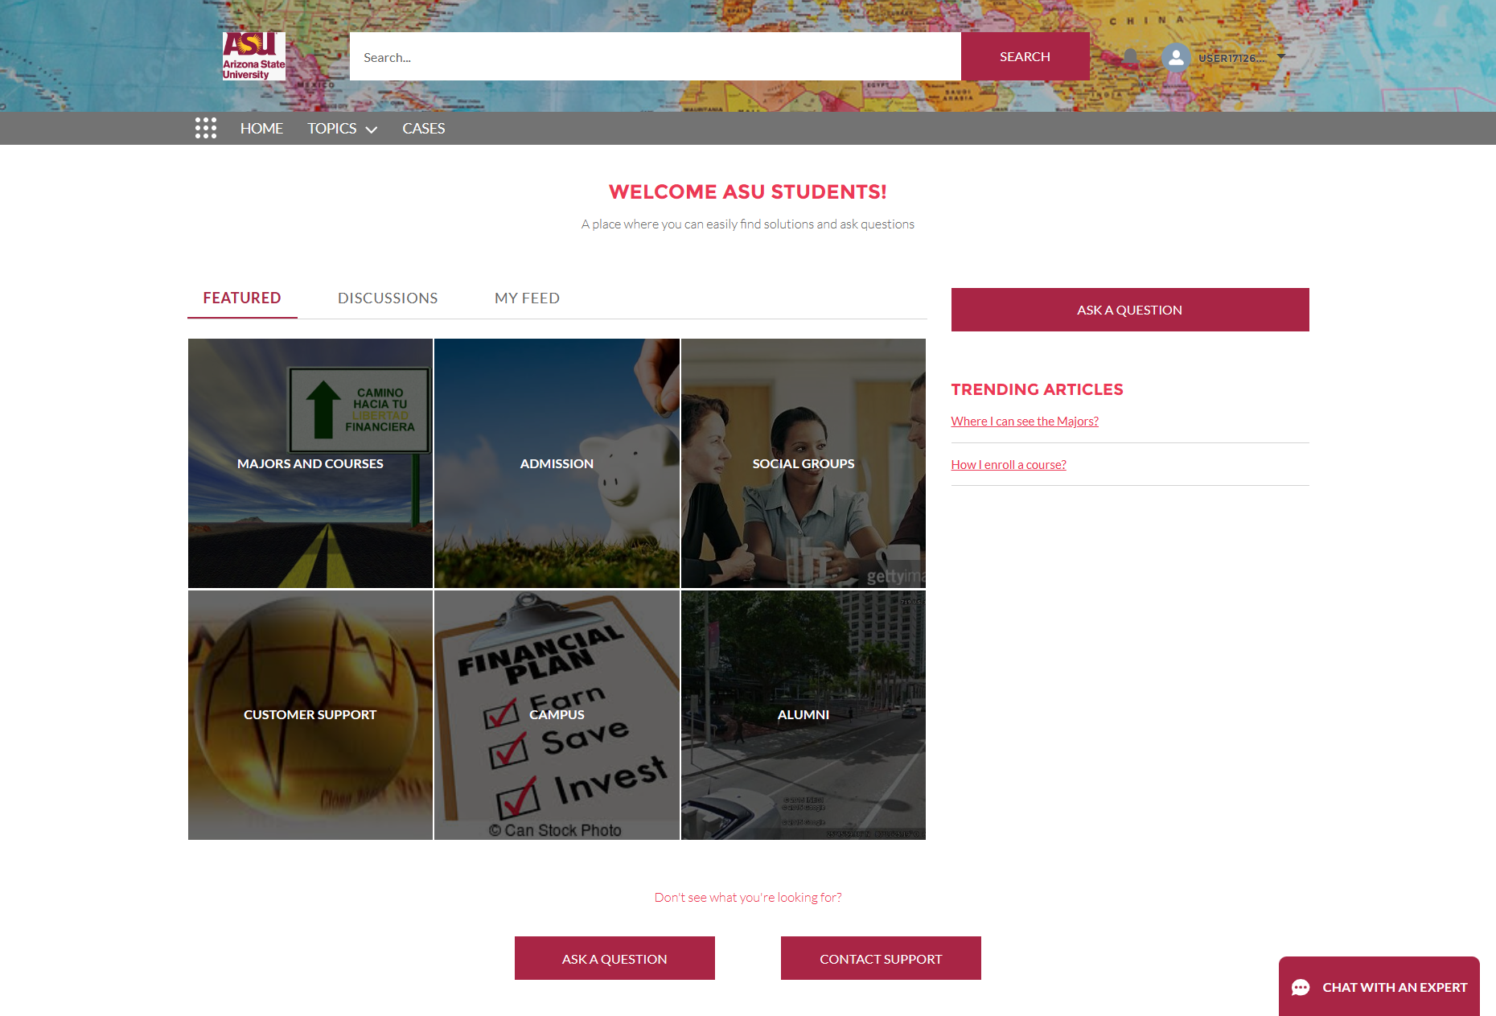
Experience Site

Slide 10
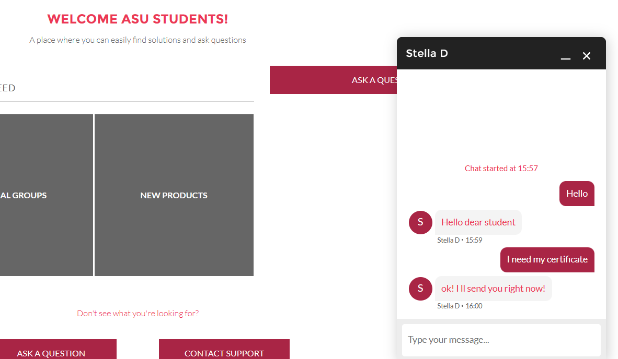
Live Chat

Slide 11
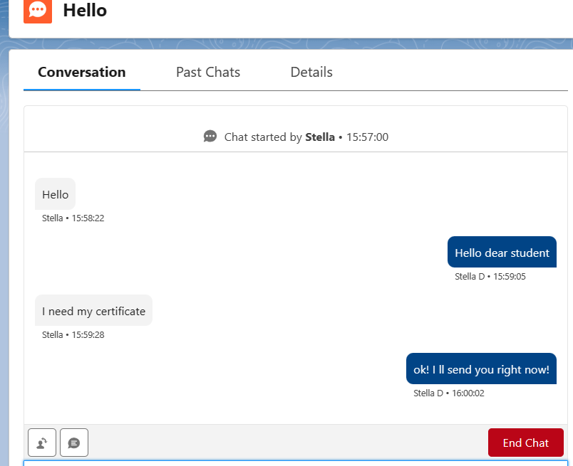
Live Chat

Slide 12
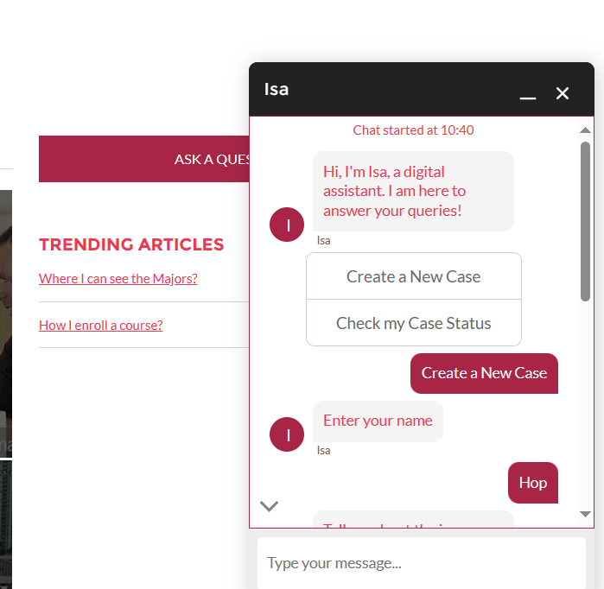
MVP 1: ChatBot
101
Create a Case

Slide 13
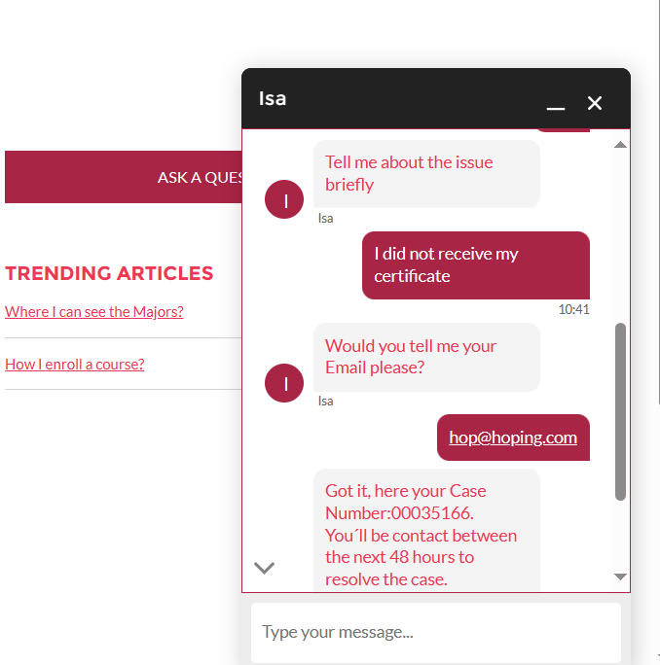
MVP 1: ChatBot
101
Case Created

Slide 14
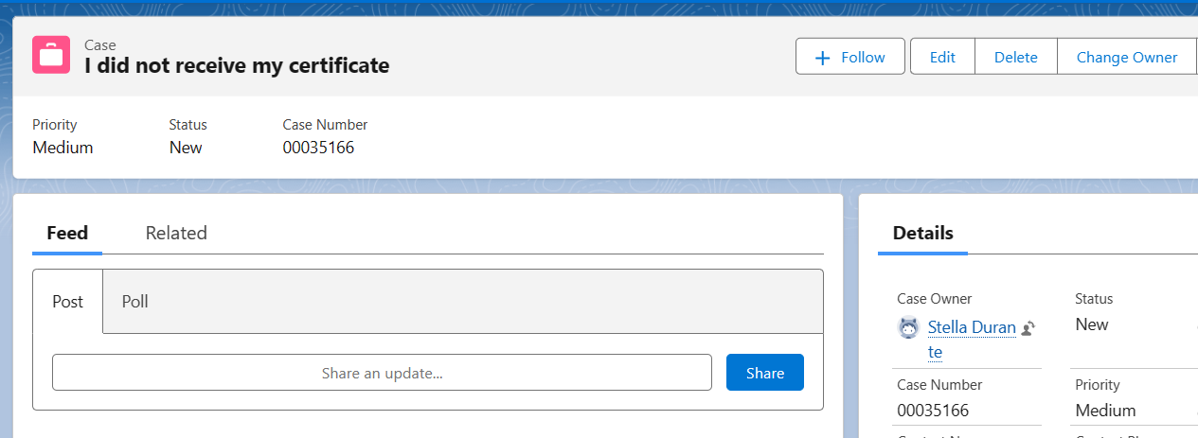
MVP 1: ChatBot
101
Case Created

Slide 15
MVP 2: ChatBot
2.0
1. Optimizing Dialogue Flows for Case Deflection: - Refine bot dialogues to address the common cases. - Implement quick replies and information-gathering steps in the dialogues to expedite resolution and avoid unnecessary case escalation. 2. Integrating Knowledge Articles and Resources: - Integrate relevant Knowledge Articles or instructional content that provides clear guidance. - Enable the bot to direct users to these resources if unable to resolve them in chat.
Next Steps:

Slide 16
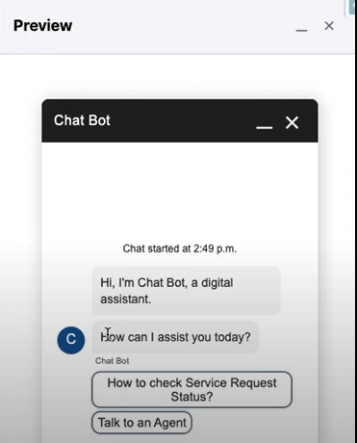
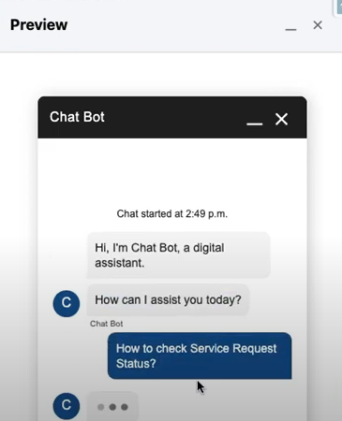
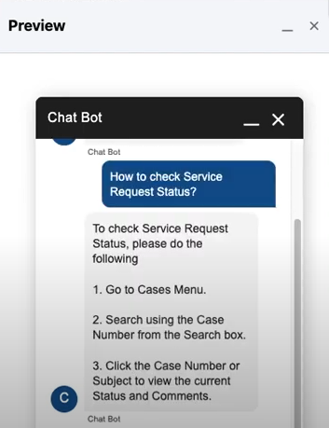
Sample

Slide 17
Thank you!
Stella Durante

